Slide 1
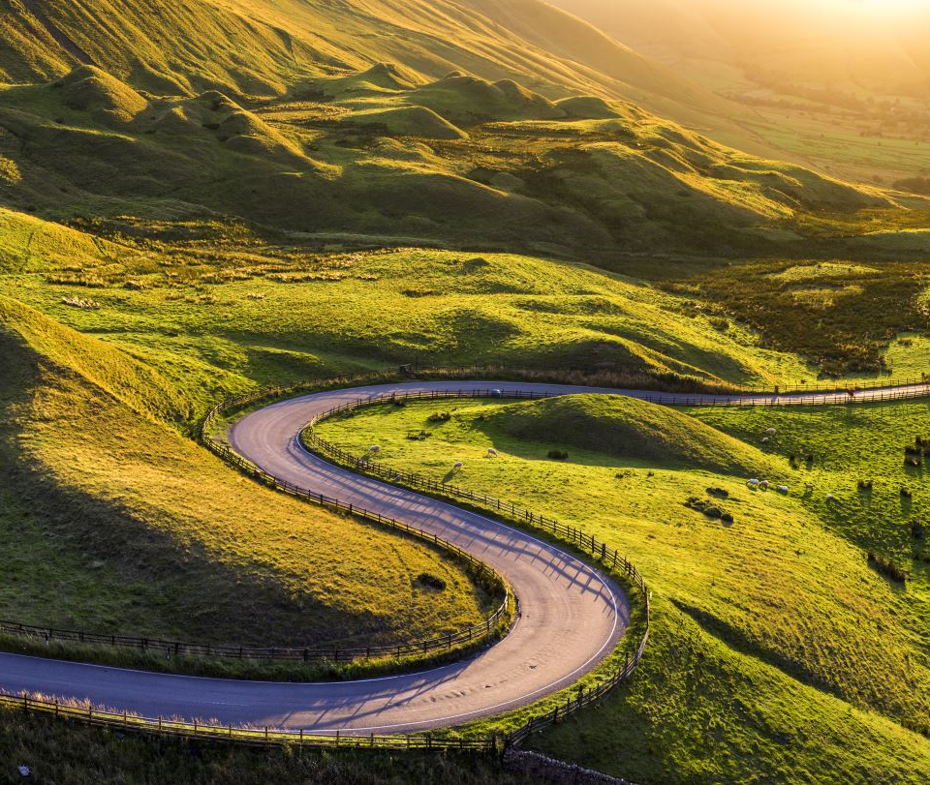
Final project – betting horses
Andrea pappa
Jake geiser
Carlie azar
Erin lee
Dave moorman

Slide 2
approach
JavaScript with Flask
D3 for Visualizations
Machine Learning using Linear SVM Model (Pandas)
Tableau for Data Visualizations
Excel Pivot Tables
Hosting on Heroku

Slide 3
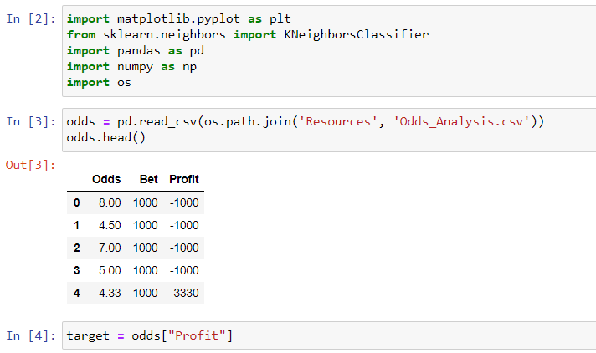

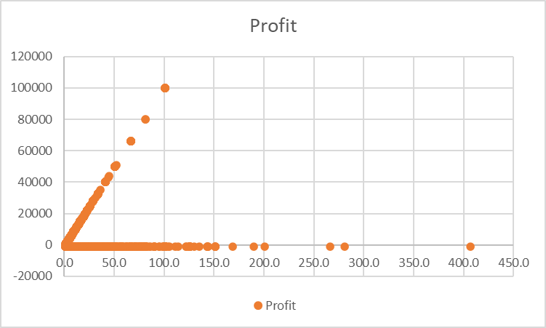

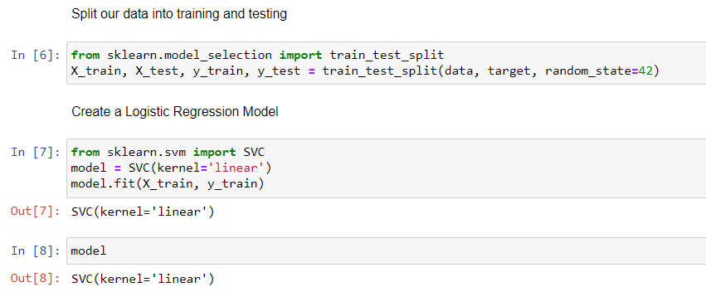
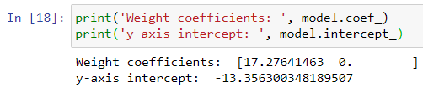
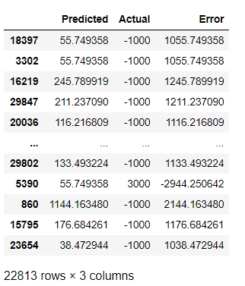
Machine learning model
Profit = -13.356 + 17.28 * odds

Slide 4
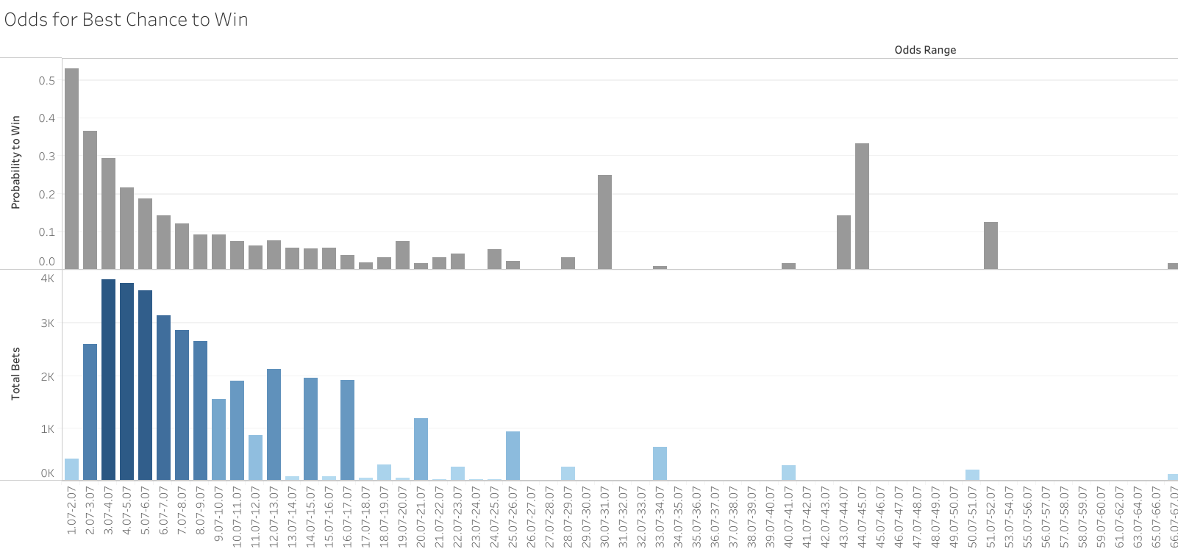
Higher chance of winning with the best odds
Data shows a 53% chance of winning with odds in the 1 to 2 range.
Gamblers won 36% of the time when betting on odds within 2 to 3.
As expected, the observed probability of winning drops down significantly as the betting odds get higher.
ODDS RANGE
https://public.tableau.com/profile/david.moorman#!/vizhome/HorseRacingOddsBetting/OddsforBestChancetoWin?publish=yes

Slide 5
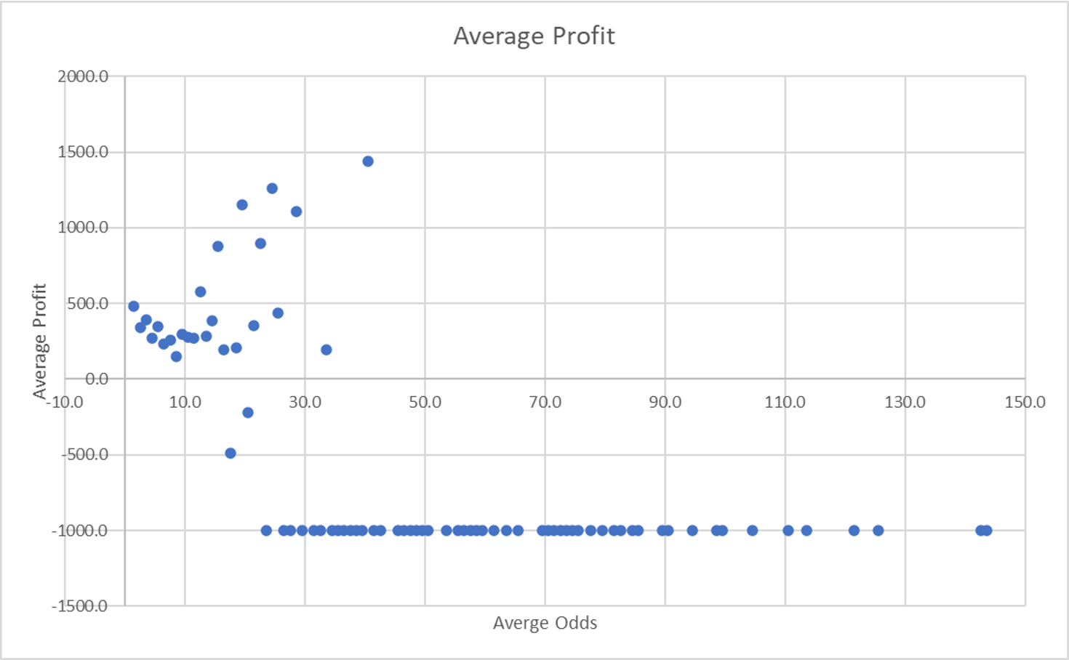
Average profit expectation per odds
Better the odds will typically provide a higher probability of profit.
Higher profit on average for lower odds, but lower probability of winning

Slide 6
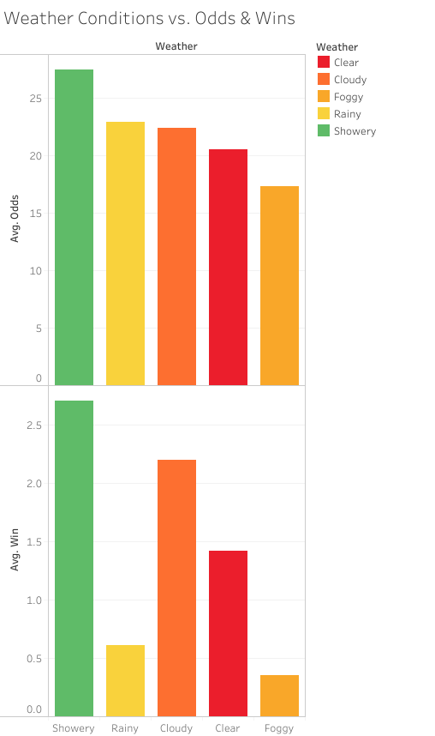
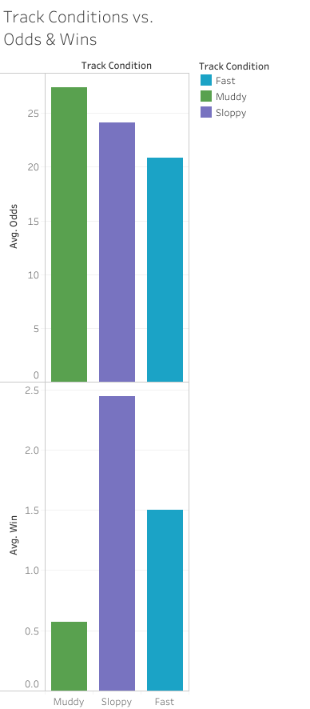
How weather and track conditions can affect horse race outcomes
Better the odds will typically provide a higher probability of profit.
Higher profit on average for lower odds, but lower probability of winning

